Slide 1
Project update
Joseph Guseman
Project Manager

Slide 2
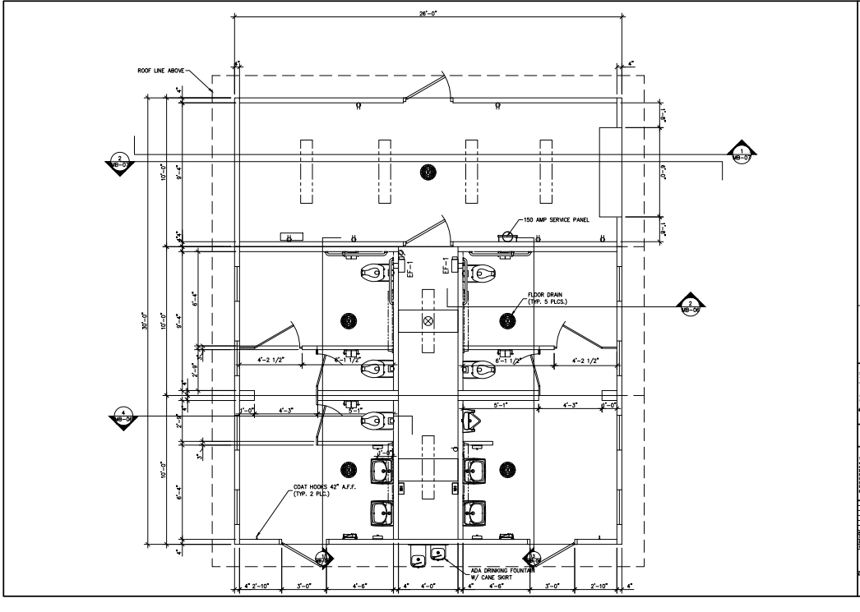
New Restroom Facility – Lake Julian Park
Notes:
B Allen construction – under contract
PO issued waiting for delivery date.

Slide 3
New Restroom Facility – Lake Julian Park

Slide 4
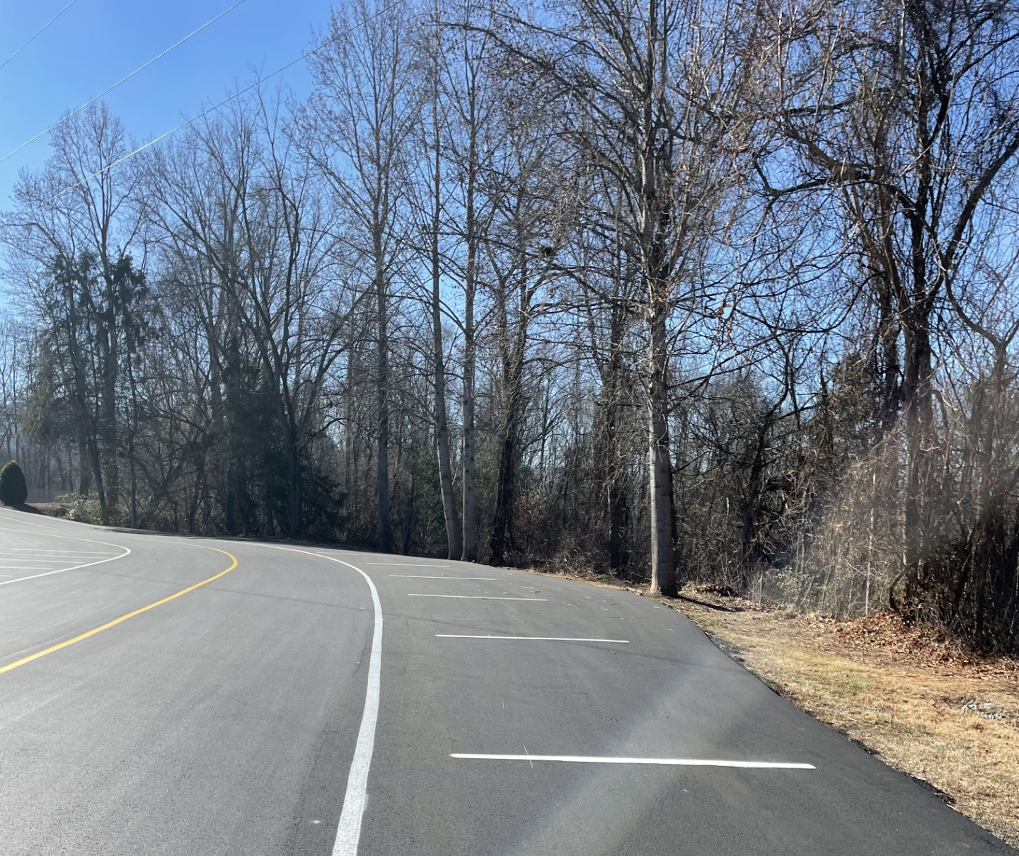
Paving Project – BCSP

Slide 5
New Lighting At Field 8

Slide 6
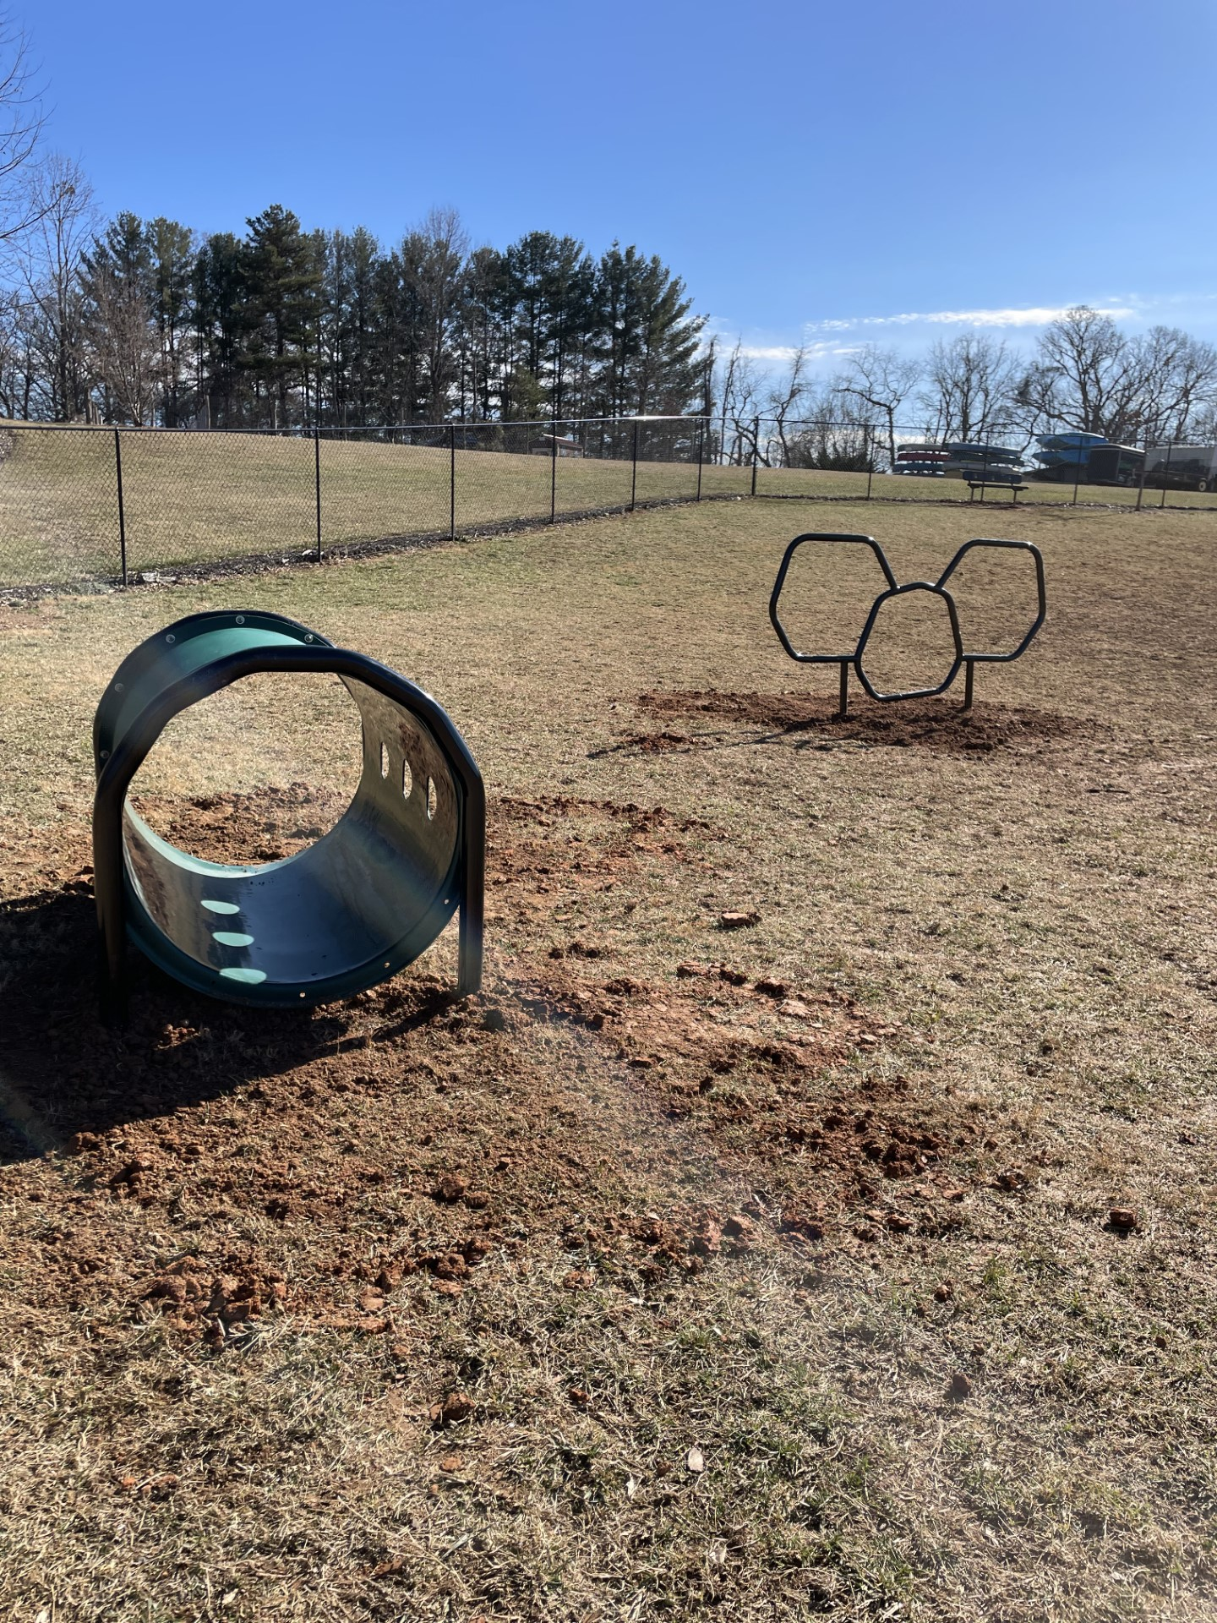
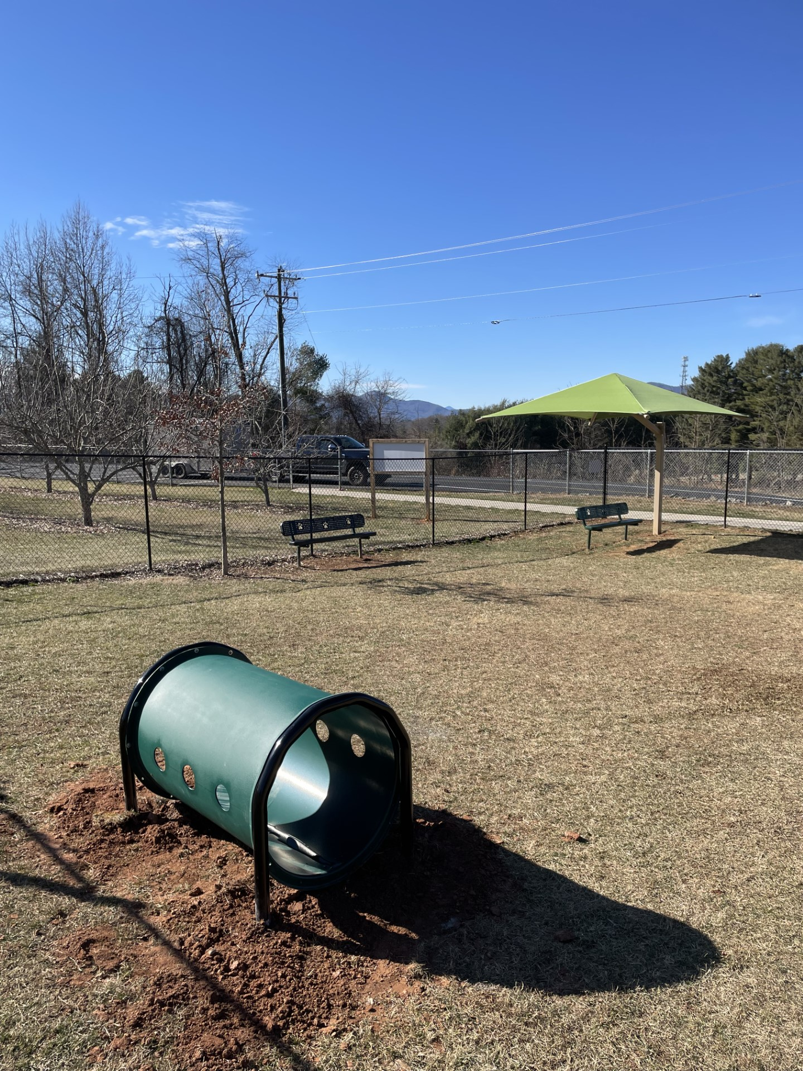
Dog Park Equipment – BCSP

Slide 7
New Safety Netting - BCSP

Slide 8
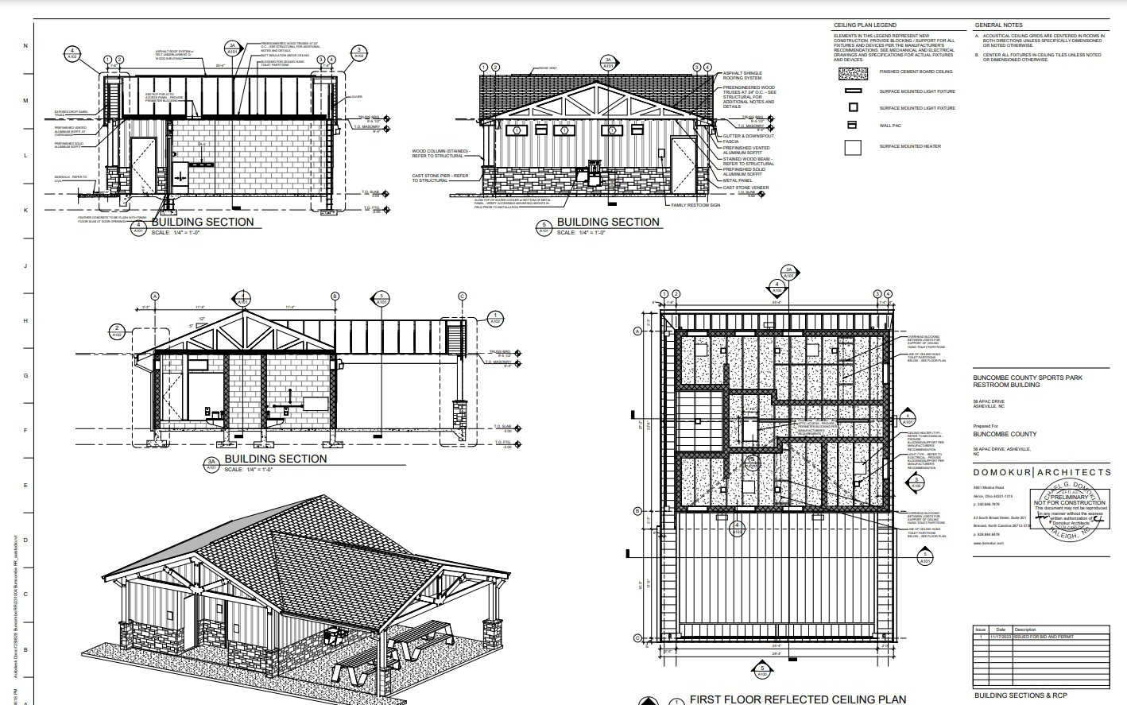
New Restroom at BCSP

Slide 9
Cane Creek Playground Fencing

Slide 10
Hazardous Tree Removal Disc Golf Course- BCSP

Slide 11
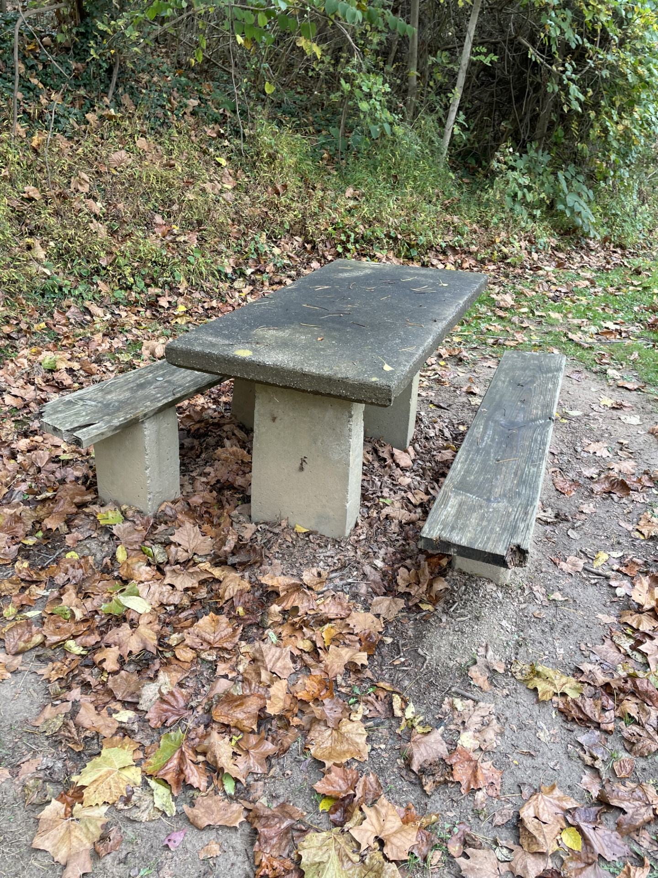
Benches at Hominy Creek Greenway

Slide 12
Questions

