Slide 1
PROJECT UPDATE
Joseph Guseman – Project Manager
Recreation Services

Slide 2
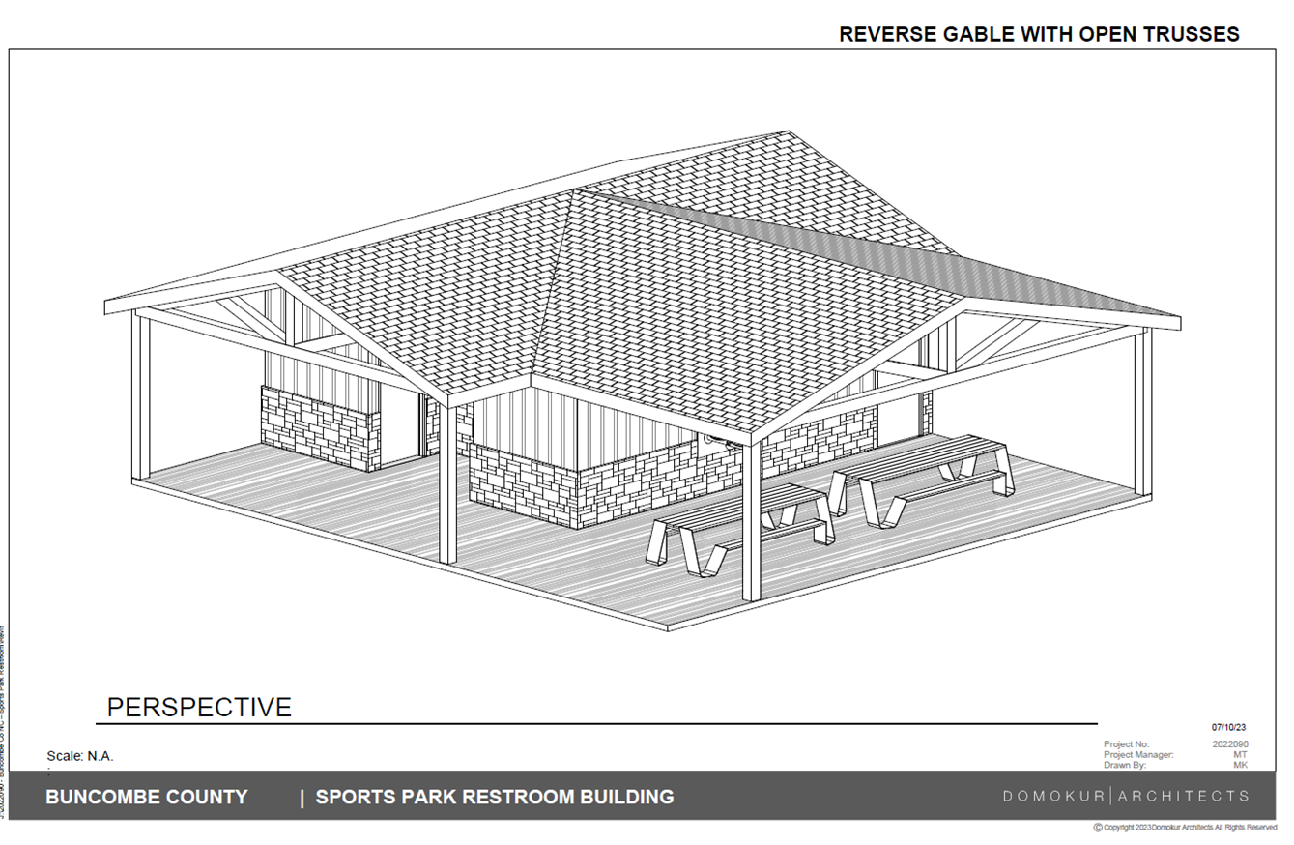
New Restroom Facility – BCSP

Slide 3
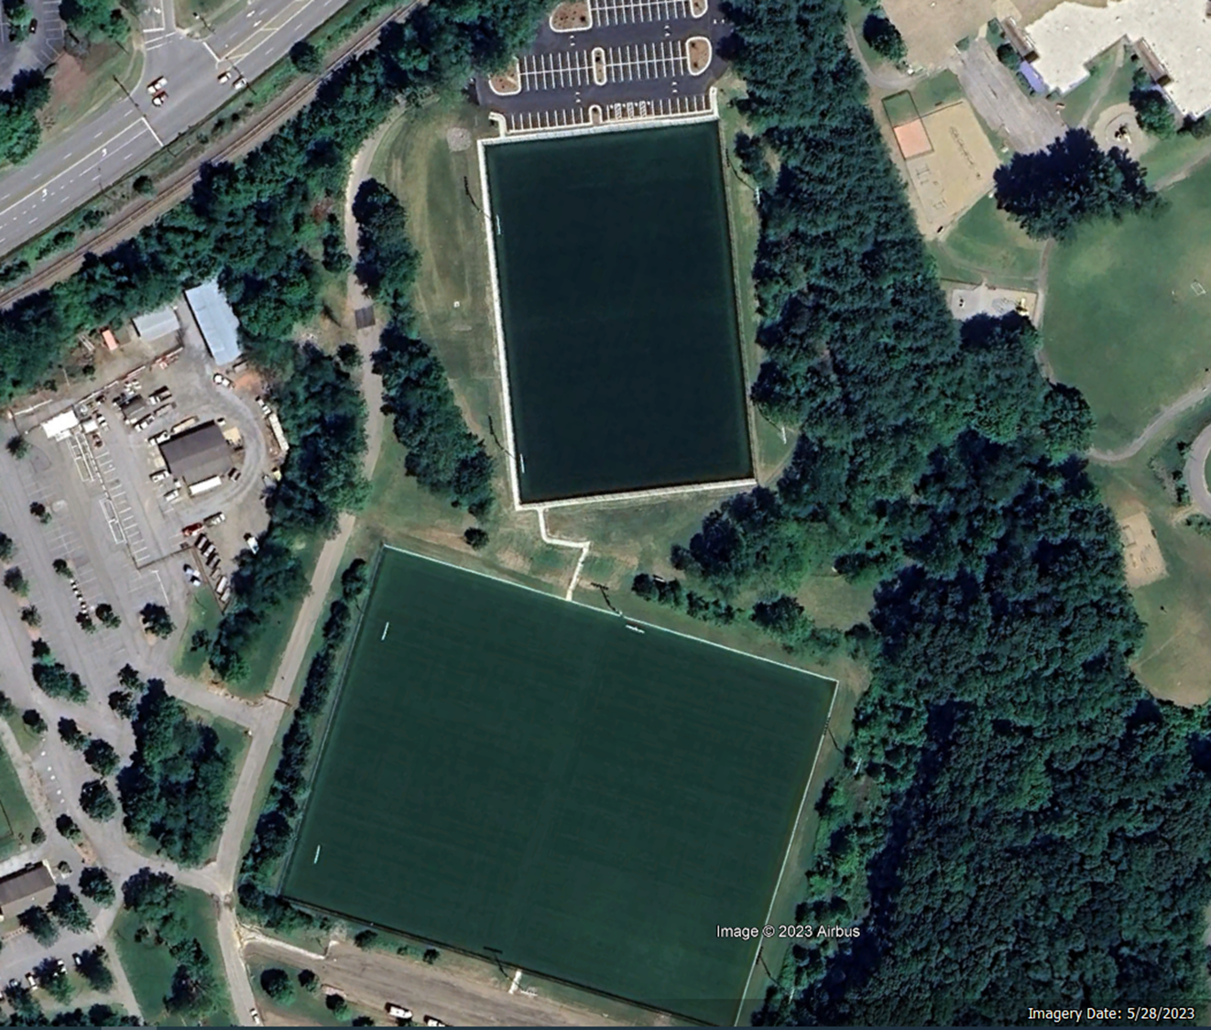

Slide 4
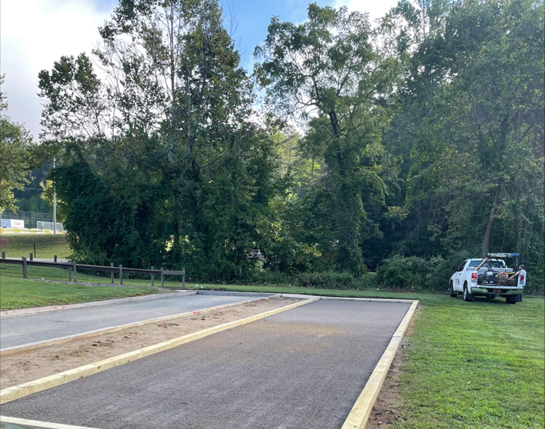
BCSP - bocce ball court repairs

Slide 5
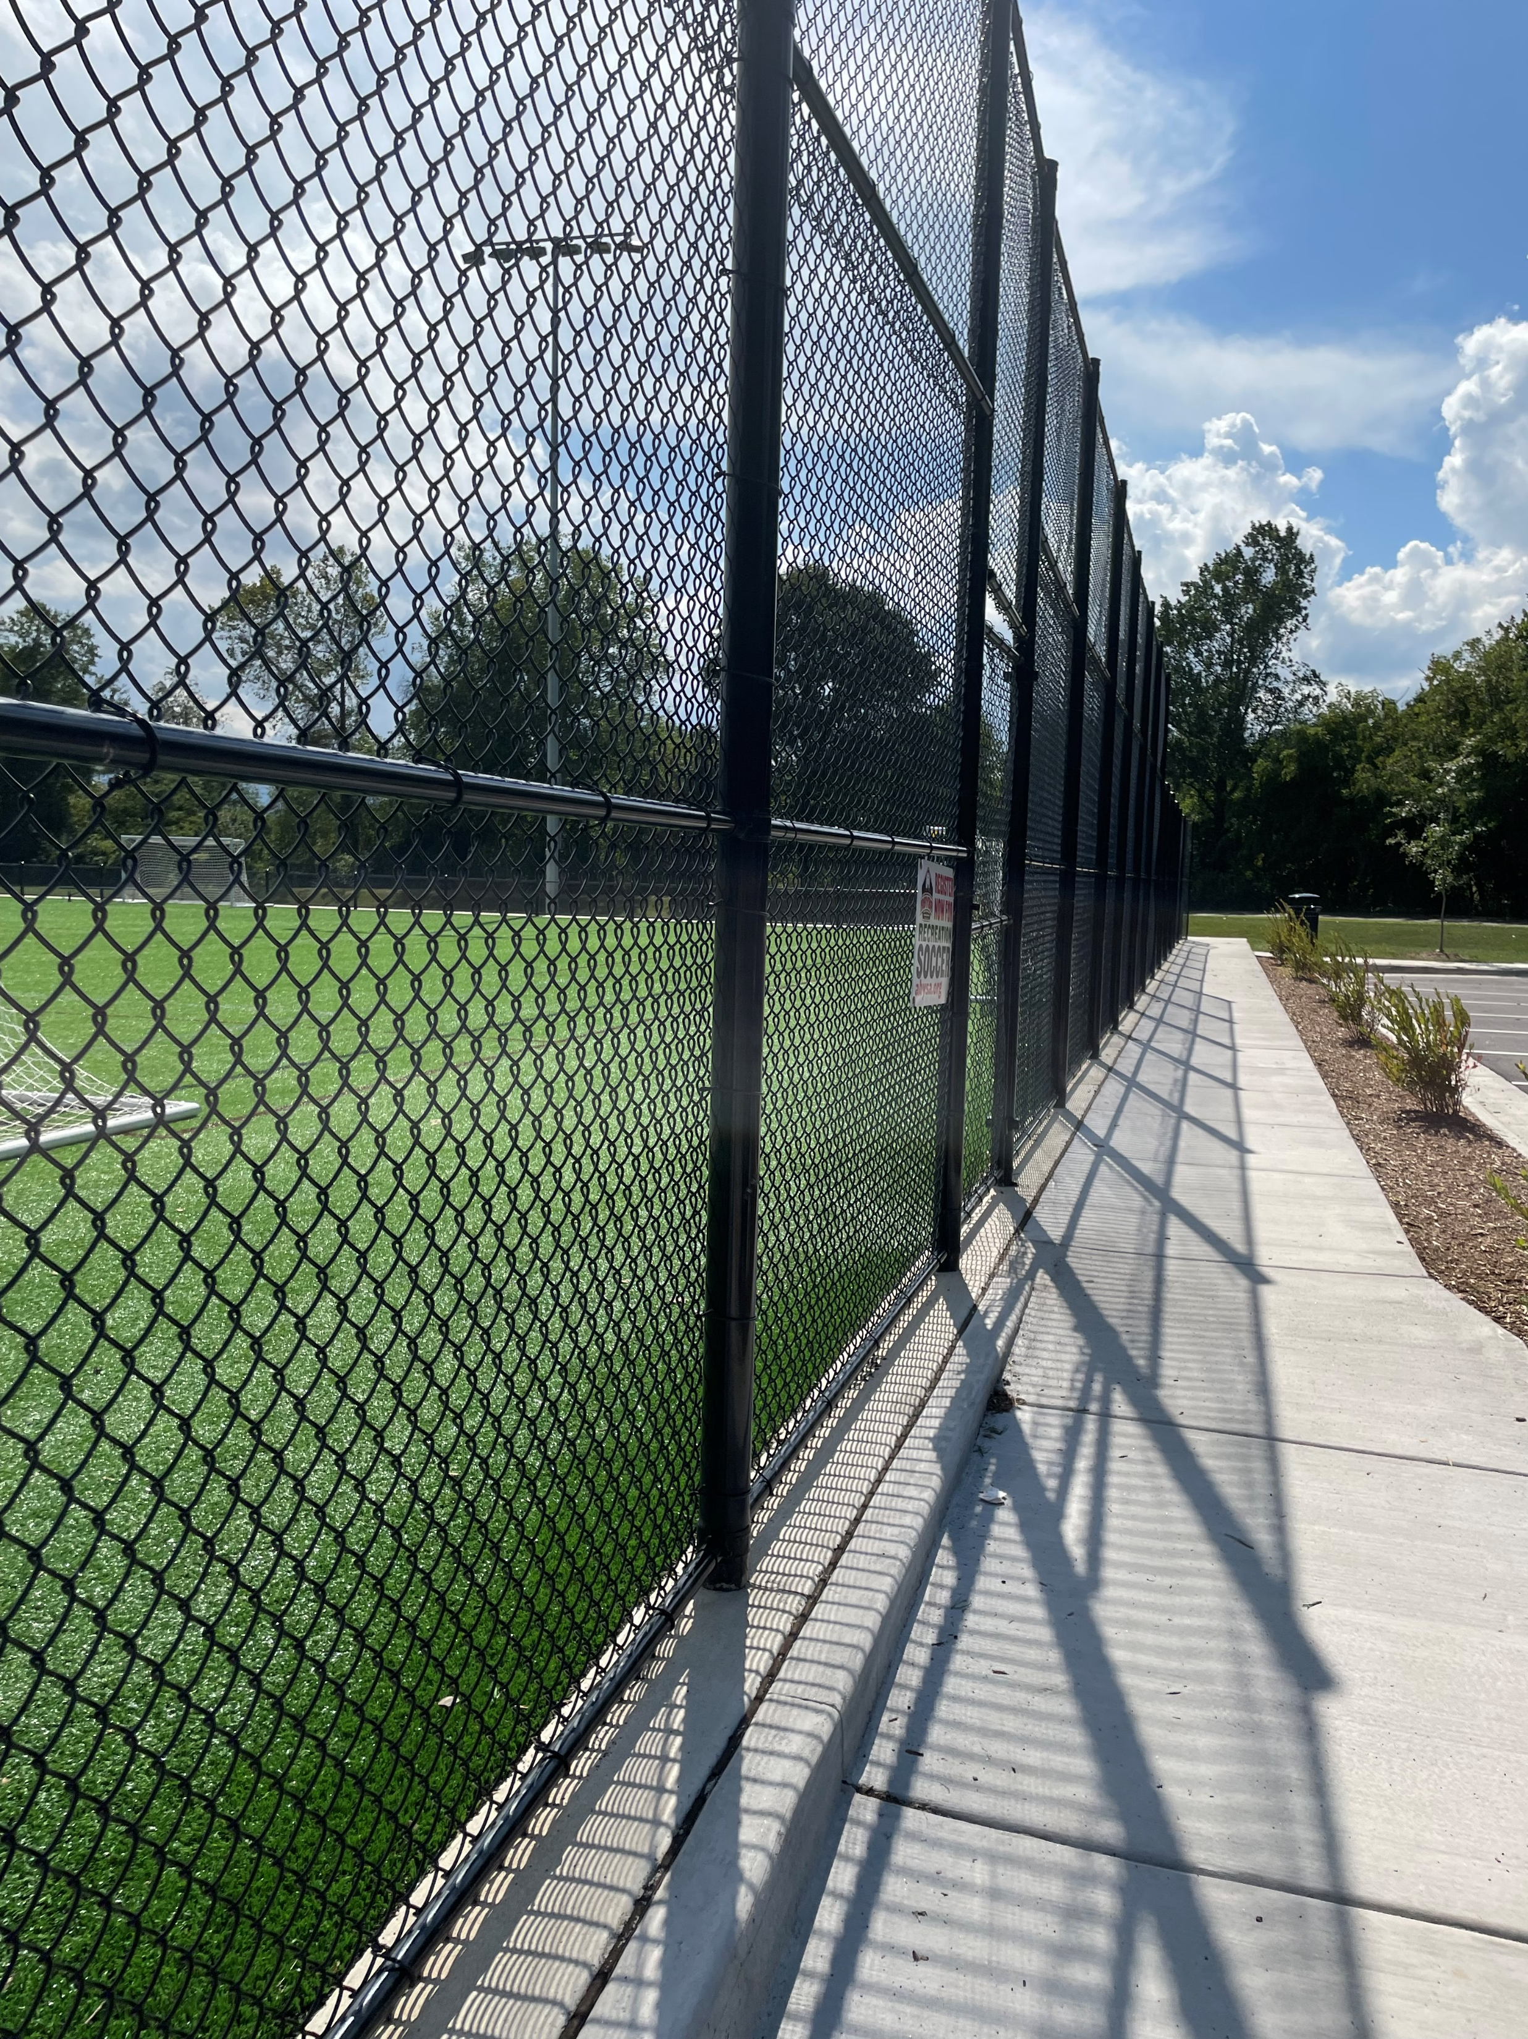
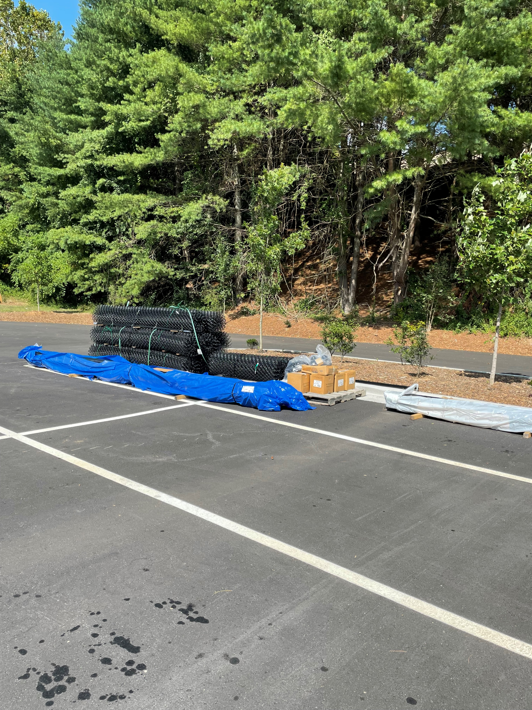
New Fencing – Fields 8, 1, 2

Slide 6
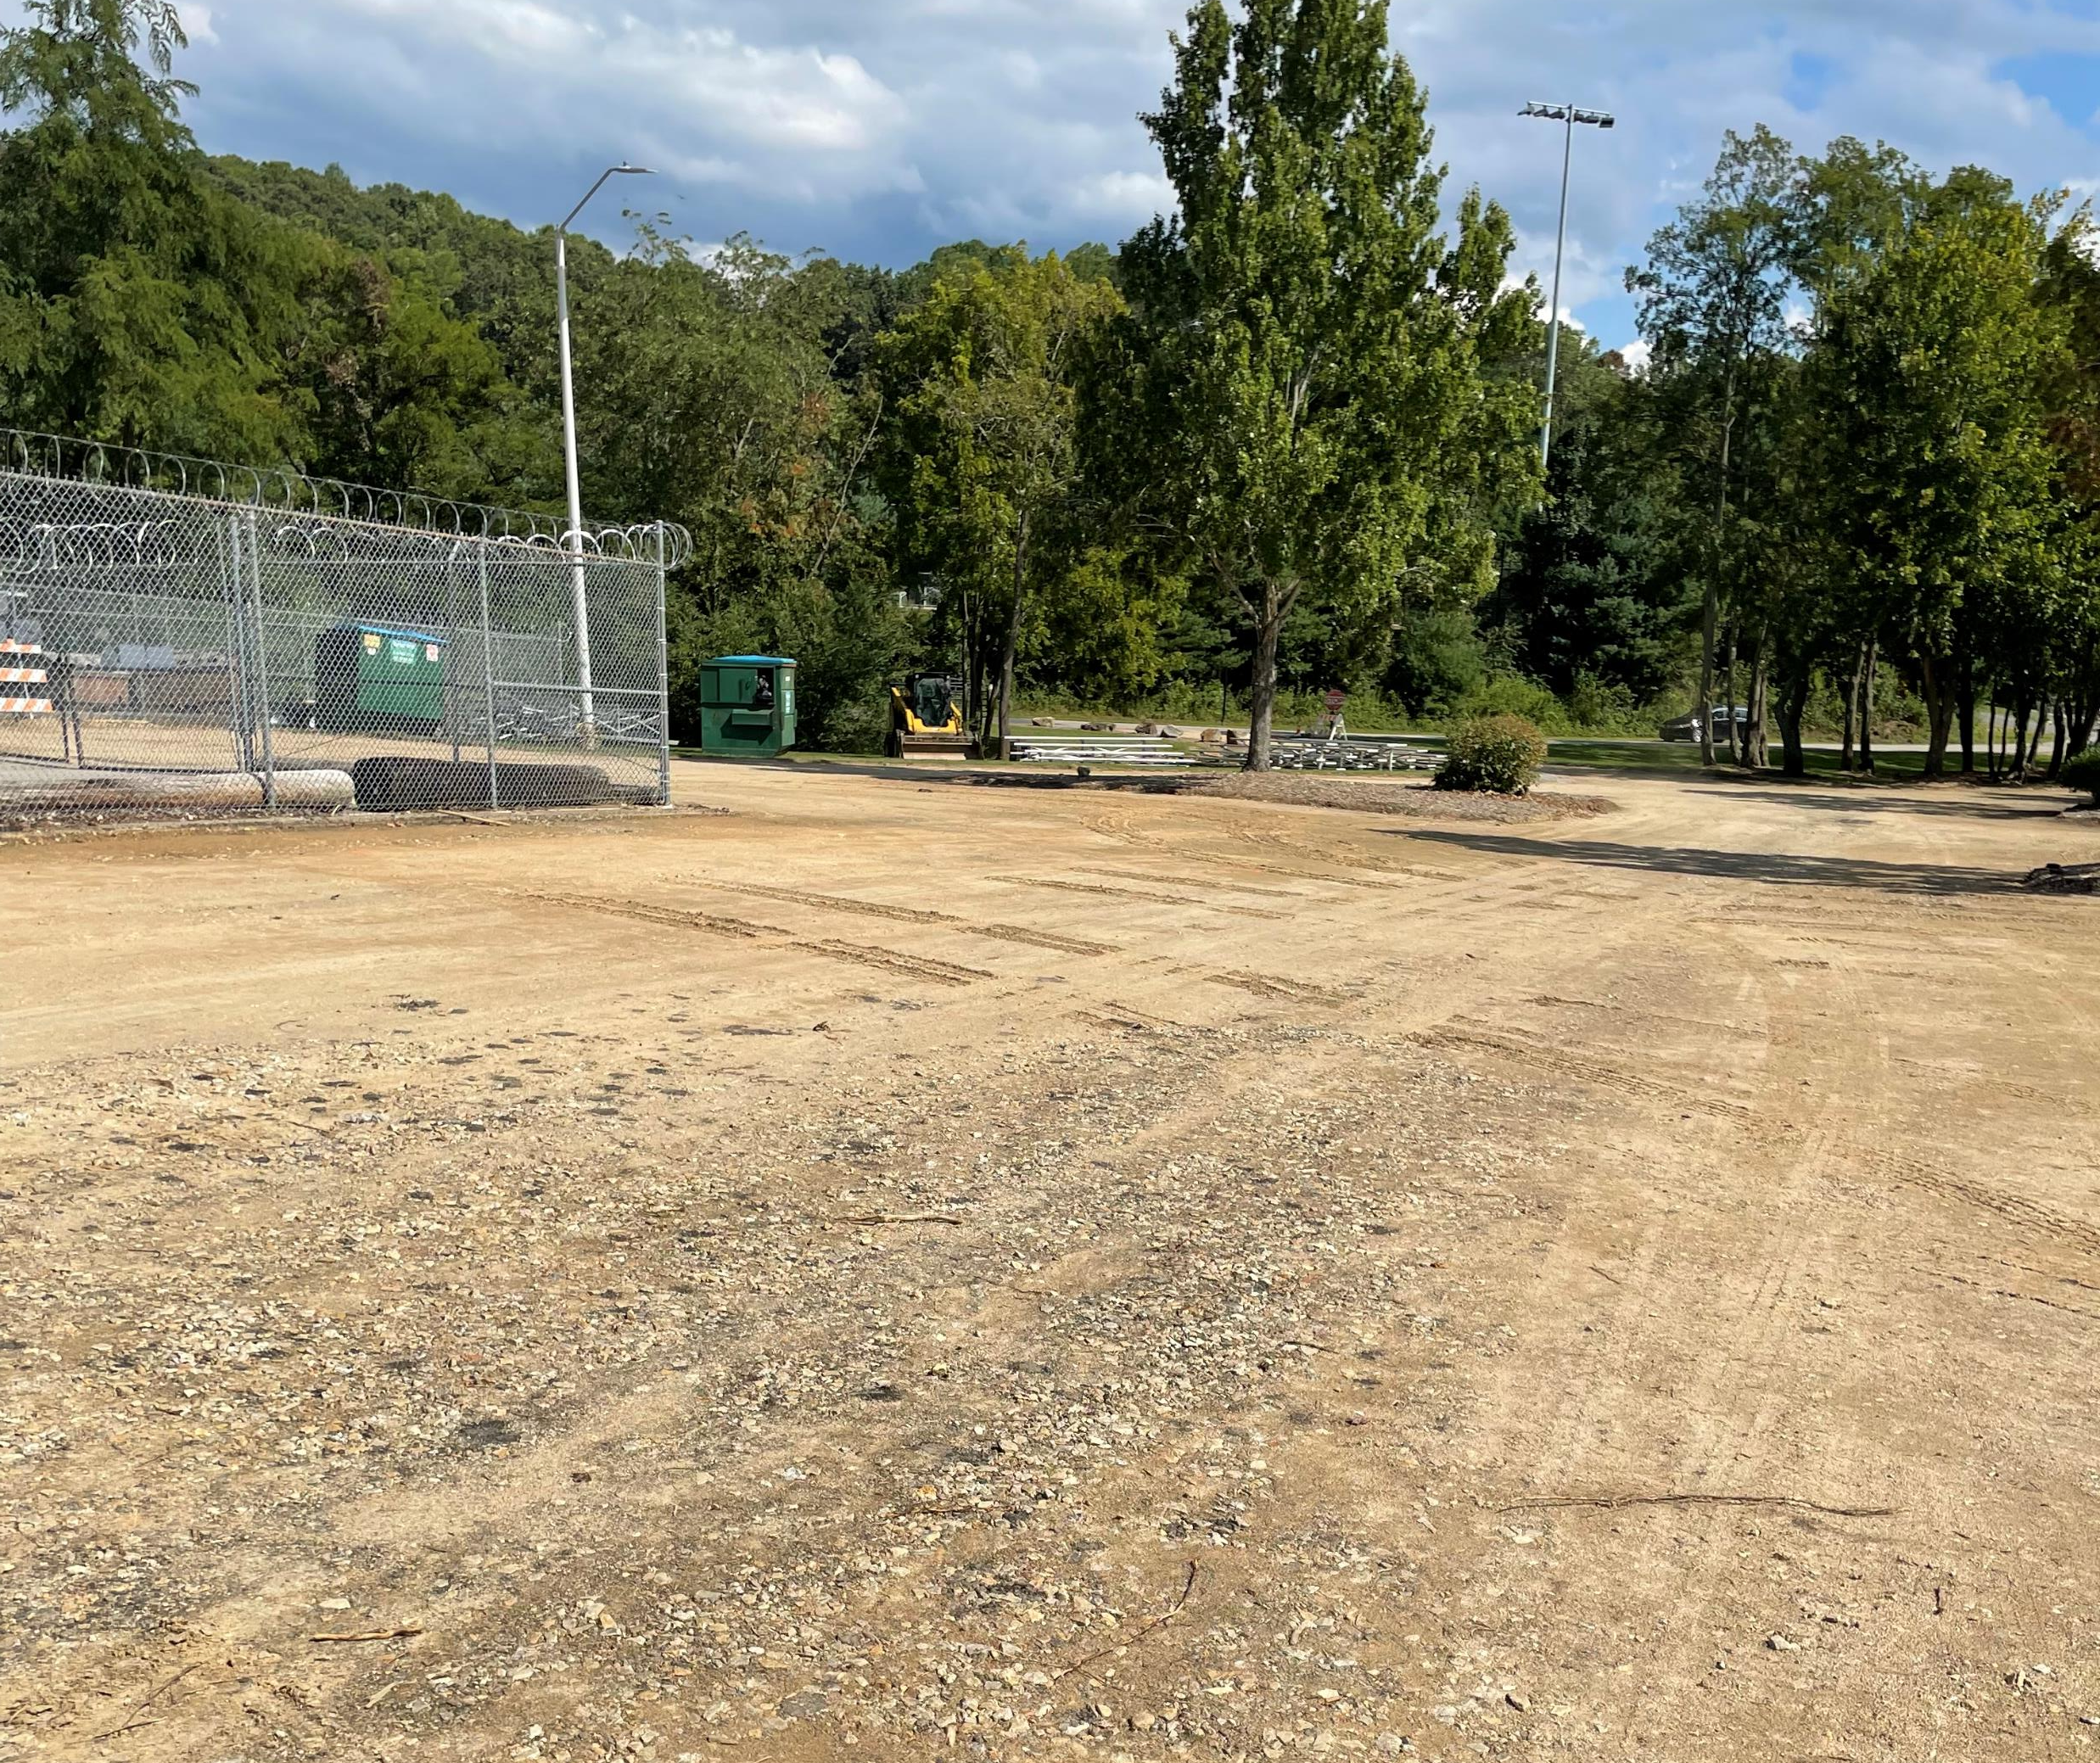
Paving Project Update – BCSP

Slide 7
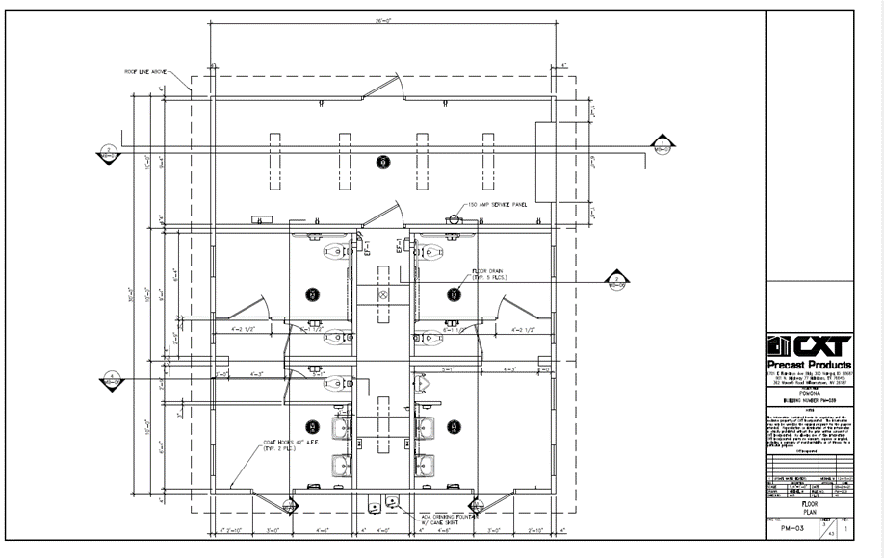
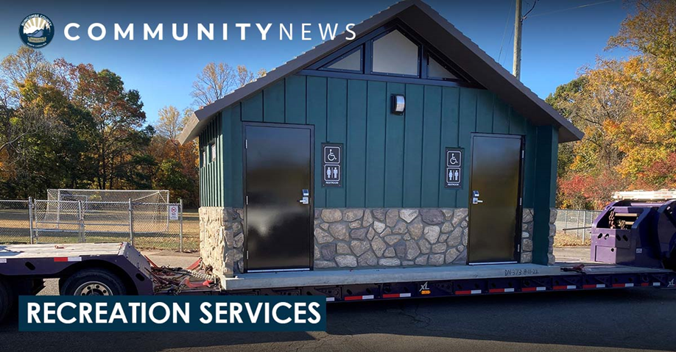
New Restroom Facility – Lake Julian Park

Slide 8
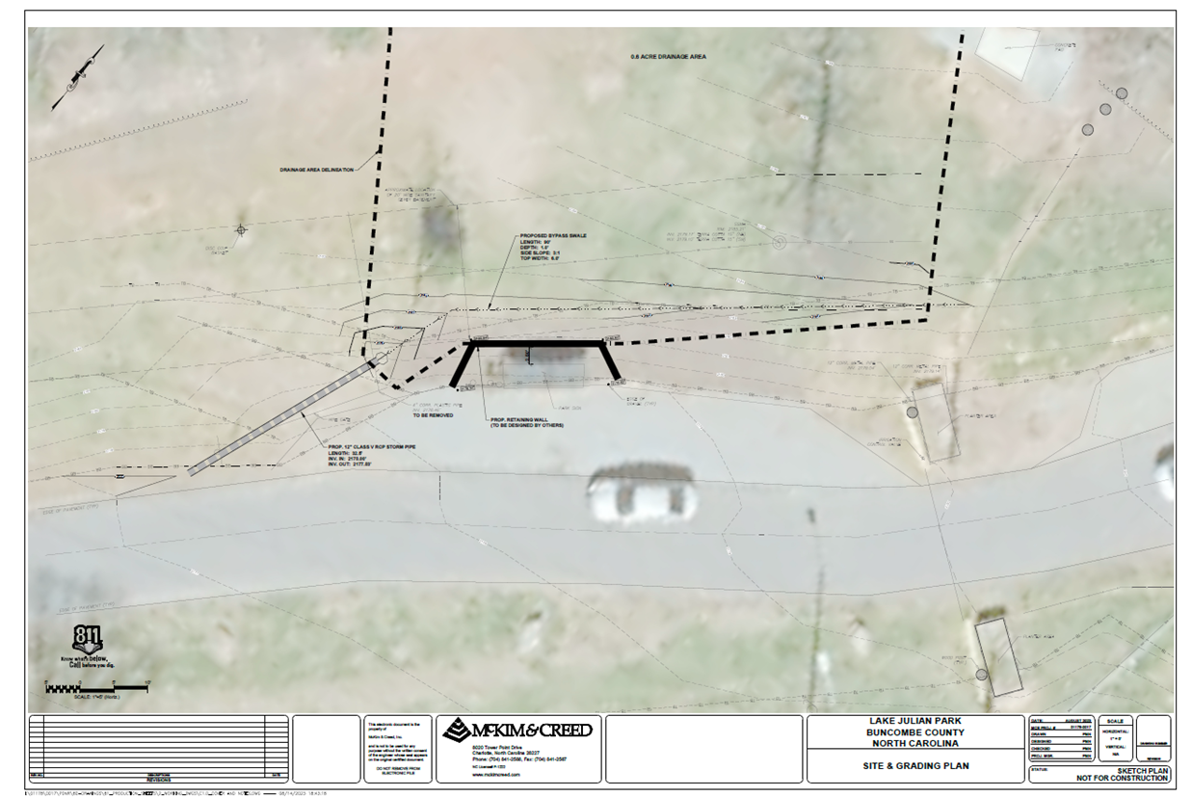
Retaining Wall – Lake Julian Park

