Slide 1
Proposal: Land and Labor Acknowledgment on BCHHS Board Website
Martha Salyers, MD, MPH
November 17, 2023

Slide 2
What is a land acknowledgment?
Formal recognition of the persons and cultures who historically occupied (and occupy) the land where one works, lives, or plays
“An effort to recognize the Indigenous past, present, and future of a particular location and to understand our own place within that relationship. Usually, land acknowledgments take the form of written and/or verbal statements.” (Native Governance Center)

Slide 3
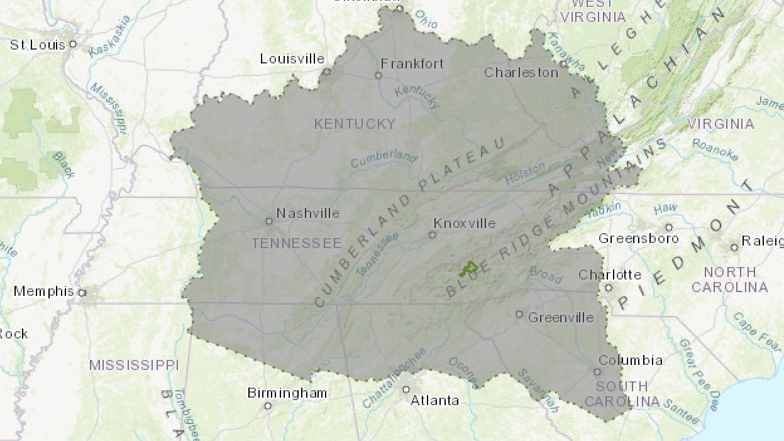
Notes:
Cherokee lands in the 1800s & today

Slide 4
--Center for Craft

Slide 5
--Asheville Citizen-Times 11/22/22

Slide 6
Controversy
Association of Indigenous Anthropologists
Lack of evidence that acknowledgments lead to change
Native Governance Center
Acknowledgment must link to action to have meaning
National Museum of the American Indian
“Making a land acknowledgment should be motivated by genuine respect and support for Native Peoples. Speaking and hearing words of recognition is an important step in creating collaborative, accountable, continuous, and respectful relationships with Indigenous nations and communities.”

Slide 7
What is a labor acknowledgment?
”A statement that recognizes that much of the economic progress and development in a geographic area or industry resulted from the unpaid labor and forced servitude of people of color, specifically enslaved African labor”

Slide 8
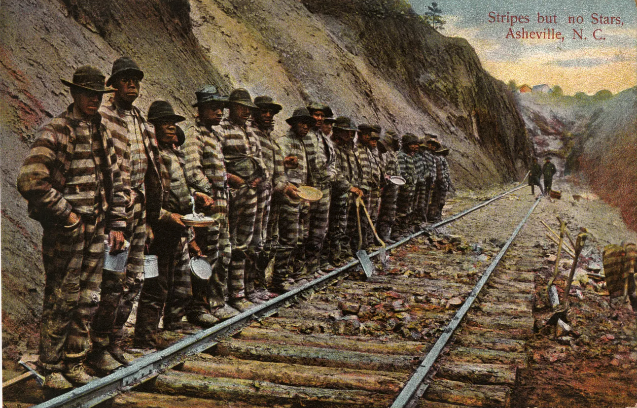
Notes:
In mid 1870’s, prison laborers, largely AA, were forced to build the railroad across NC, including thru Avl. (13th Amendment loophole—involuntary servitude permissible if used as punishment for crime.
Yes, there was slavery here despite claims that with no plantations there was none. Many famous names in Avl were slaveowners -- Patton, Chunn, Weaver, Woodfin (largest slaveholder in Bunc), Vance

Slide 9
Why would the BCHHS Board have a land and labor acknowledgment?
Recognition of history – and present
Gratitude
Fairness
Opportunity for dialogue, partnership, and reparation
Consistency across county government
Notes:
History: we stand on Cherokee land; we know the crimes committed in taking the land and forcibly removing the people
Present: 782 927 Up 18% in last decade
Gratitude: for the care & love indigenous ancestors showed this land we love
Fairness: aka justice
Dialogue with EBCI and with each other about historical wrongs that need to be righted
Consistency: Register of Deeds Buncombe County recognizes that the entirety of the Anigiduwagi land was unjustly taken by the United States in cooperation with the State of North Carolina. As citizens on that land, we have benefited from the inhumane actions they took. By acknowledging the historical context of this land, our hope is that Buncombe County and the State of North Carolina will begin the process of strengthening our relationship with our indigenous neighbors. Buncombe County Government recognizes that there is a lot of work to do, and we look forward to initiating a longer conversation about partnering with the thriving community that is the Eastern Band of Cherokee Indians.
Always asking: What partnerships can we build and sustain that further health equity in meaningful ways?
Question: Is it better to ignore or be quiet about injustice, past or present, or be open about it, though it may be painful, awkward, or controversial? Only one of those paths leads to bending the arc toward justice.

Slide 10
--USA FACTS/ US Census 2022
Notes:
AI/AN up ~18% .3%
AA no significant change; 5.8%
Asian up ~35%
H/L up ~ 30%; 7.5%
White NL 85→83%

Slide 13
Resources
Native Governance Center, www.nativegov.org “A Guide to Indigenous Land Acknowledgment’; “Beyond Land Acknowledgment: A Guide”
National Museum of the American Indian
David E. Whisnant
Dr. Darin Waters
Fitchburg State University “Understanding Land and Labor Acknowledgments” https://fitchburgstate.libguides.com/c.php?g=1128891&p=8246097#:~:text=A%20labor%20acknowledgement%20is%20a,Color%20%2D%20specifically%20enslaved%20African%20labor.
Buncombe County Register of Deeds “As Long As The Grass Shall Grow” https://storymaps.arcgis.com/stories/e9913eb717dc4e68aebe7a7c7d3f42c3 and “Forever Free” https://www.buncombecounty.org/governing/depts/register-of-deeds/slave-deeds/default.aspx.
UNCA Center for Diversity Education

