Slide 1
Community Input Sessions: Coxe Avenue
Buncombe County
February 22, 2024

Slide 2
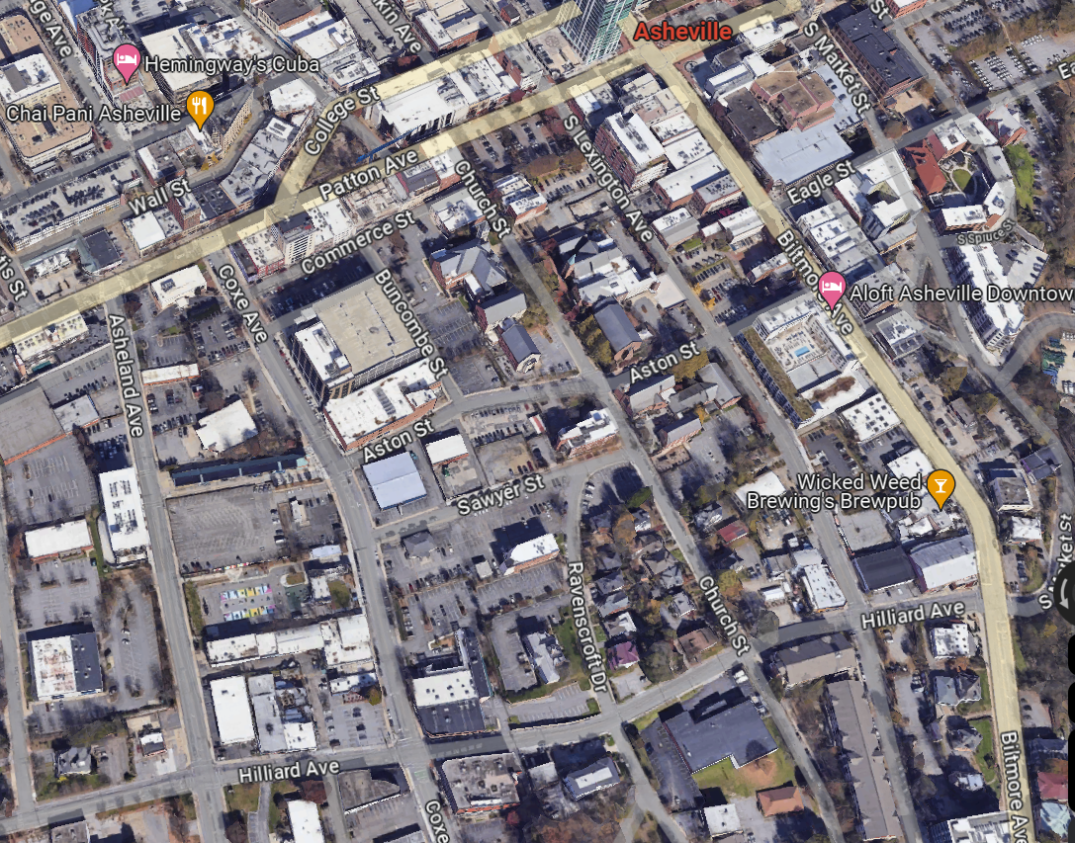
Input Session Overview
Process History and Overview
Development Options
Discussion in Small Groups:
How well do these plans meet each guiding public interest?
Which of the plans does a better job of meeting each interest?

Slide 3
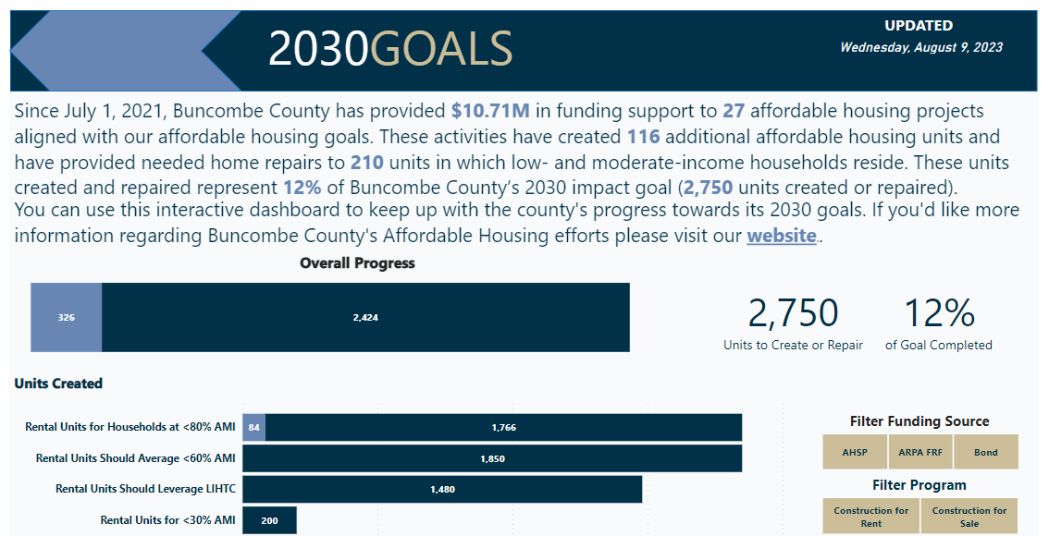
Buncombe County has significant need for rental units affordable to low- and moderate-income households
Over 8,900 LMI renter households and 5,800 LMI owner households in Buncombe County are spending more than 50% of their income on housing or living in overcrowded homes.
https://www.buncombecounty.org/governing/depts/planning/ah-county-goals.aspx

Slide 4
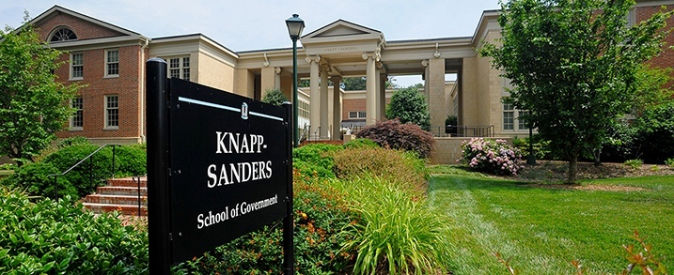
UNC School of Government (SOG)
UNC Chapel Hill’s School of Government is the largest university-based local government training, advisory, and research organization in the United States, and serves more than 12,000 public officials each year.

Slide 5
Development Finance Initiative (DFI)
DFI is a program of SOG that works with communities in NC to attract private investment for transformative projects.
DFI brings:
Real estate development and finance expertise
Ability to bridge public and private interests
Neutrality, non-partisanship, responsiveness

Slide 6
Guiding public interests endorsed by the Buncombe County Commission following spring 2023 engagement:
Development of the 50-52 Coxe Avenue site should:
Maximize the number of new apartments affordable to low- and moderate-income households in a mixed income setting.
Include active ground floor uses that serve residents and commuters and increase pedestrian traffic along Coxe Avenue.
Maintain direct and safe access from Coxe Avenue to Church Street for pedestrians and cyclists.
Balance maximum density and pedestrian-scale design that extends the vibrant, urban streetscape from Patton Avenue to the South Slope area.
Attract as much private investment as possible in order to maximize the impact of public investment in affordable housing.

Slide 7
DFI Process Overview
Feasible Development Plan
Site
Analysis
Guiding Public Interests
Financial
Analysis
Market Analysis
Goal: Identify private development partner(s) to finance, build, and operate project(s) that meets community vision

Slide 8
Funding for Affordable Rental Development
Funding Gap
Public or charitable source
Deferred Developers' Fee
Can defer up to 50% of fee
Low-Income Housing Tax Credit (LIHTC) Equity
9% and 4% Tax Credit: Sold to private investors for equity
May cover between 40% and 90% of capital needed
Unit affordability must be (on average) affordable to households at 60% AMI
Guarantees 30 years of affordability
Private Loans
Federally-guaranteed → below market interest rates and terms
Notes:
LIHTC
9% tax credits: Maximum $1.2M
Limits size of project
Most of Asheville in Difficult Development Area. Most of the rest of Buncombe doesn’t receive boost?

Slide 9
Development Options
How well do these plans meet each guiding public interest?
Which of the plans does a better job of meeting each interest?

Slide 10
 | Option 1: 52 Coxe Only | Option 2: 50-52 Coxe Avenue
Total Affordable Units (30-80% AMI) | 130 | 200
Potential Commercial Space | 2,200 SF | 5,900 SF

Slide 11
Site Considerations
All plans include demolition of existing building that currently houses Bureau of Identification.
At least 70 percent of the street-level façade along Coxe must be composed of windows, doors and other openings.
Assumes 0.6 parking spaces per unit.
Funding source (LIHTC) requires all parking on site.
One option includes partial closure of street to increase footprint.
All options require conditional zoning process through City of Asheville.
Notes:
Challenges with the quality of the soil increase complexity and cost of construction.

Slide 12
Additional Considerations
Plans are conceptual:
Visualize the footprint, height, and density
Enough detail to inform estimated construction costs but still require developers to be creative.
Do not include architectural elements such as color, texture, materials, etc.
Non-residential, non-amenity space in a LIHTC development:
Must be occupied by a community service facility that primarily serves residents earning less than 60% AMI.
OR if income-producing and not primarily serving low-income households, must be owned by an entity other than LIHTC developer

Slide 13
Option 1: 52 Coxe Avenue
Apartments | 130 Rental Units
30% AMI | 29 units
50%-60% AMI | 75 units
80% AMI | 26 units
Potential Commercial Space | 2,200 SF
Estimated Public-Private Investment | $38.5M
Potential Funding Gap | $4.2M
SAWYER ST.
RAVENSCROFT DR
COXE AVENUE

Slide 14
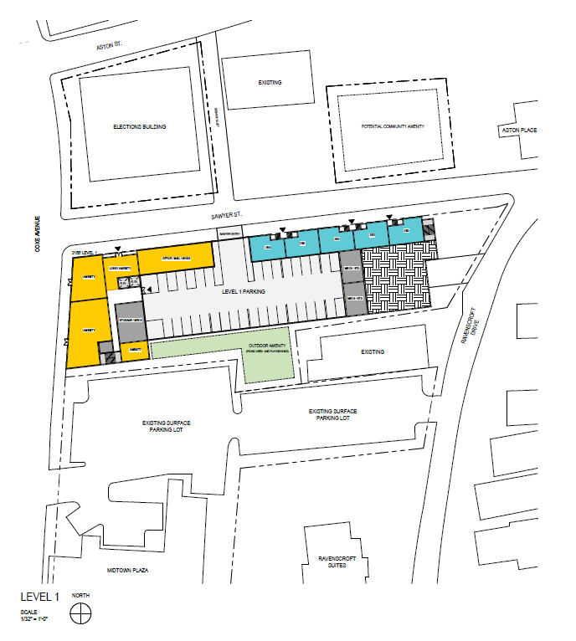
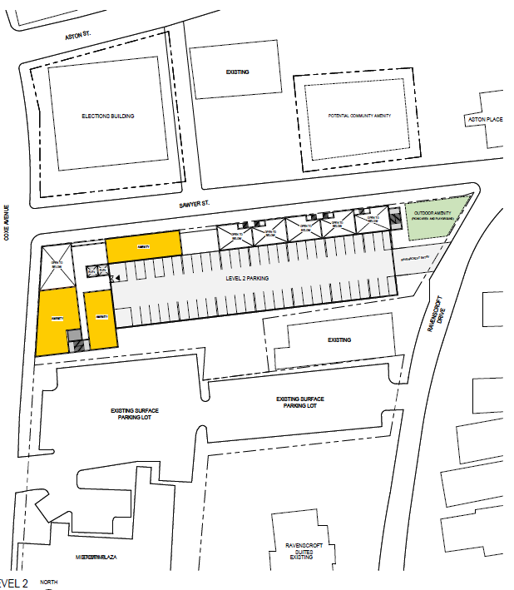
Option 1: 52 Coxe Avenue
Rental Units
Amenities & Non-Residential
Parking
Outdoor Amenity
LEVEL 1
LEVEL 2

Slide 15
Option 2: 50-52 Coxe Avenue
Apartments | 200 Rental Units
30% AMI | 42 units
50%-60% AMI | 119 units
80% AMI | 26 units
Potential Commercial Space | 5,900 SF
Estimated Public-Private Investment | $59.0M
Potential Funding Gap | $9.8M
SAWYER ST.
RAVENSCROFT DR
COXE AVENUE
Notes:
$49,000 per unit

Slide 16
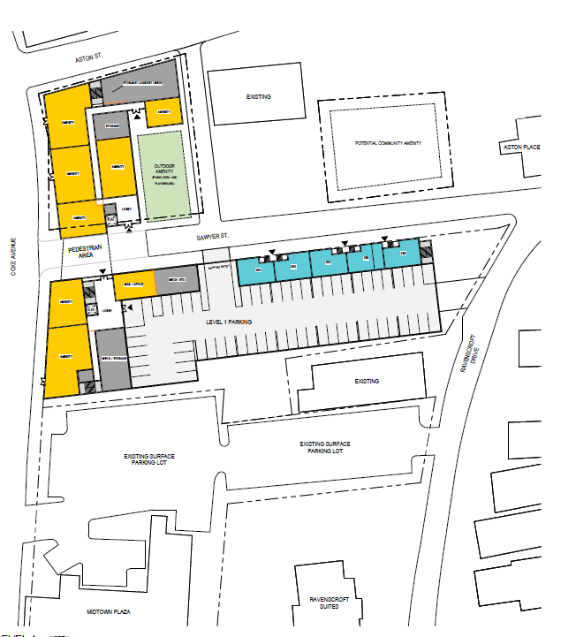
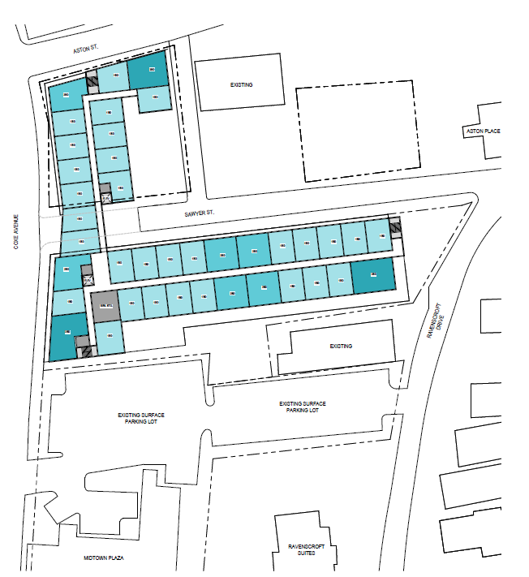
Option 2: 50-52 Coxe Avenue
Rental Units
Amenities & Non-Residential
Parking
Outdoor Amenity
LEVEL 1
LEVEL 3-7

Slide 17
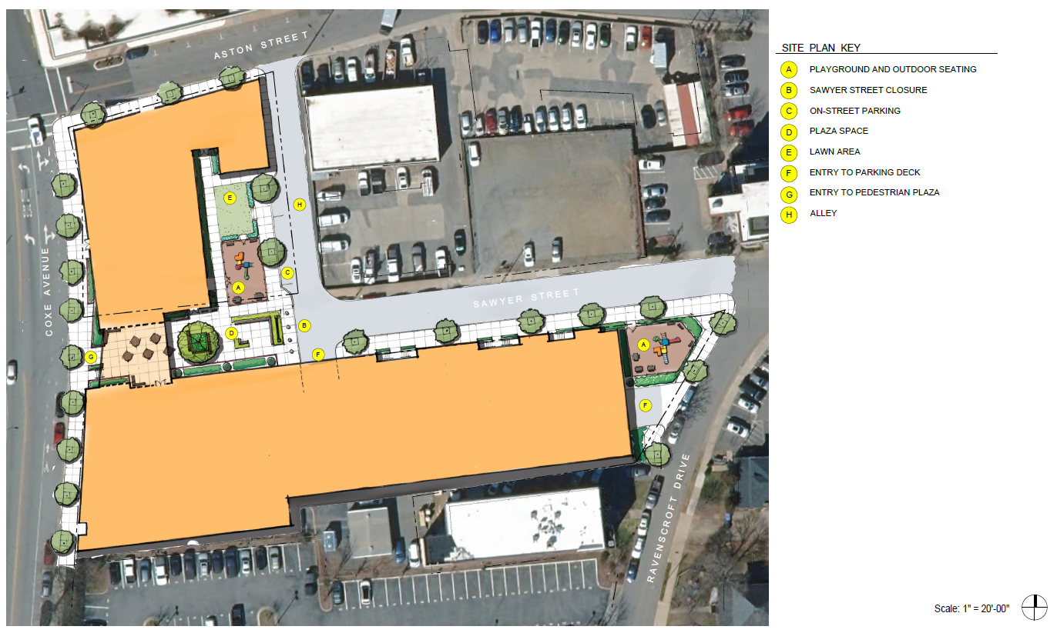

Slide 18
 | Option 1: 52 Coxe Only | Option 2: 50-52 Coxe Avenue
Total Affordable Units (30-80% AMI) | 130 | 200
Potential Commercial Space | 2,200 SF | 5,900 SF
Estimated Costs
Construction Cost | $38.5 M | $59.1 M
Land Cost | $2.0 M | $3.2 M
Funding Gap 9/4% or 4% only | $4.2 - $10.4 M | $9.8 - $16.1 M
Per Unit | $32,200 - $80,200 | $49,200 - $80,700

Slide 19
Next Steps

Slide 20
Potential Development Timeline
Community Engagement
Selection of Preferred Plan
Development Partner Solicitation
Negotiate and Execute Agreements
Developer: Construction Begins
Developer: Tenant Selection
 | Jan-March | April – June | July – Sept | Oct – Dec | Jan – Mar | April – June | July – Sept | Oct – Dec | Jan-March
 | 2024 |  |  |  | 2025 |  |  |  | 2026
*Timeline is an estimate and subject to change to allow for thoughtful engagement and decision-making, LIHTC application process, and potential market shifts.
*Timing of community engagement to be determined in conjunction with County staff following selection of sites. Note: Timeline subject to change based on delays in Phase 2 site selection, type and scale of community engagement, and other delays in Board decision making.

Slide 21
Discussion
Break into small groups with a facilitator.
Discussion today will focus on the guiding public interests and participants will be asked the following for each:
How well do these plans for 50 and 52 Coxe Avenue meet this guiding public interest?
Which of the plans does a better job of meeting this interest?

Slide 22
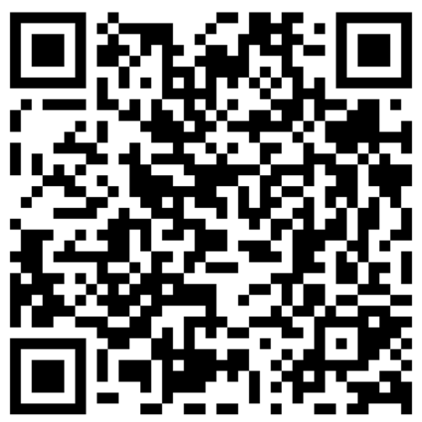
Visit PublicInput.com/AffordableHousingDevelopment to learn more and sign up for updates.

Slide 23
Summary of Housing Needs
Over 8,900 LMI renter households and 5,800 LMI owner households in Buncombe County have severe housing needs.
Demand greatest for units to accommodate small elderly households and small families.
Pressure on LMI households increasing across all housing types, as rents and cost of living rise, and vacancy remains low.
Stock of unsubsidized affordable housing at risk and approximately 915 subsidized units set to expire in next 10 years.
Homeownership increasingly out of reach as interest rates and home prices rose.

Slide 24
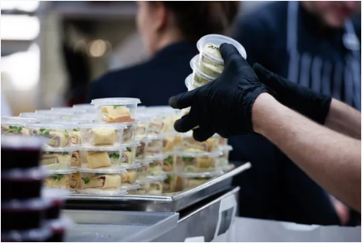
Who will affordable housing serve?
 | 30% AMI | 50% AMI | 60% AMI | 80% AMI | 100% AMI
1–Person Income | $17,850 | $29,750 | $35,700 | $47,600 | $59,500
 | Earning <60% AMI
 | Food Prep, incl Fast Food | Personal Care Aide | Childcare Worker | Medical Assistant
Annual Mean Wage | $19,920 | $21,620 | $24,049 | $31,300
Max Housing Expense | $500 | $540 | $600 | $780
Earning <80% AMI | Earning <80% AMI
Social Service Specialist |  | Elementary School Teacher
$40,047 |  | $46,113
$1,000 |  | $1,150
Source: MTSP Income Limits 2023, NC Department of Commerce

Slide 25
Area Median Income (Family of 4): $90,300
Extremely Low-Income
Low-Income
Low-to-Moderate Income
Household Size | 30% AMI | 60% AMI | 80% AMI
1-Person | 17,850 | 35,700 | 47,600
2-Person | 20,400 | 40,800 | 54,400
3-Person | 22,950 | 45,900 | 61,200
4-Person | 25,500 | 51,000 | 68,000
5-Person | 27,540 | 55,080 | 73,440
6-Person | 29,580 | 59,160 | 78,880

Slide 26
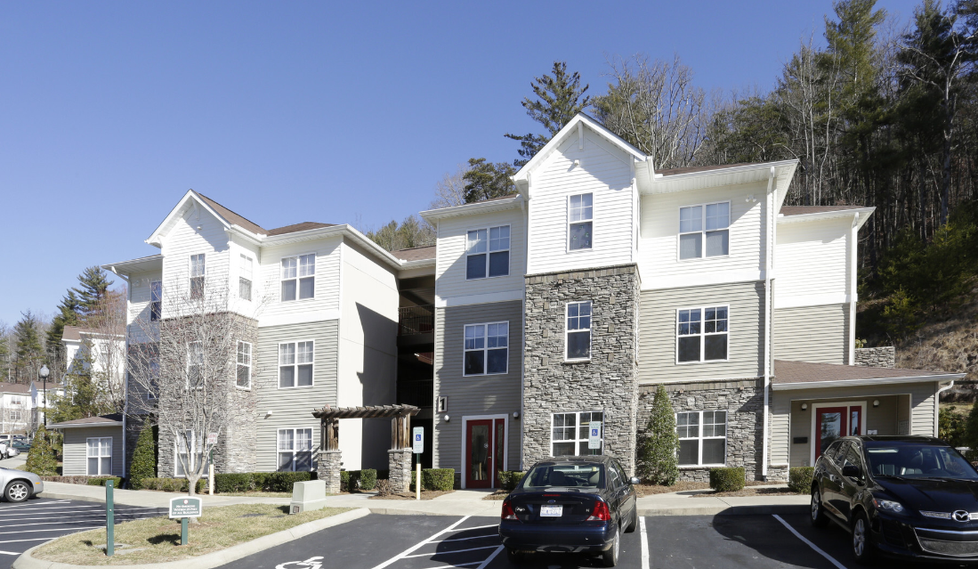
Affordable Housing in Buncombe County
Notes:
North Point, Carmel Ridge, East Haven

